Slide 1
College of Arts and Sciences

Slide 2
Notes:
A message from Dr. Sam Huckaba, Dean of the College of Arts and Sciences.

Slide 3
Arts and Sciences at a Glance
Notes:
The College of Arts and Sciences is the largest and most academically diverse college at Florida State University. It is the academic home to more than 11,000 undergraduate and graduate students studying across 18 departments and 14 programs, institutes and centers, and encompassing 200-plus degree offerings. More than 100,000 Arts and Sciences alumni live and work worldwide. Each year, 47 percent of the undergraduate credit hours taught at FSU are delivered in the college, and Arts and Sciences awards approximately 2,600 degrees at the undergraduate and graduate levels.

Slide 4
Arts and Sciences Departments and Programs
Notes:
Visit artsandsciences.fsu.edu/departments-and-programs for a comprehensive listing that includes Arts and Sciences academic units serving undergraduate and graduate students.

Slide 5
Degree Requirements
Two levels of requirements must be met before graduation
University requirements
Arts and Sciences, or college, requirements
Major
Minor
Foreign language
Notes:
Earlier in orientation, you learned about the university graduation requirements. In this presentation we will briefly highlight the graduation requirements for the College of Arts and Sciences.
As a student in the College of Arts and Sciences you must complete a major, minor, and demonstrate foreign language proficiency.

Slide 6
Major Requirements
Major specific:
Talk to your departmental adviser every semester BEFORE registration opens.
Major-specific advising happens tomorrow.
Major resources
Academic Program Guide: academic-guide.fsu.edu
Undergraduate Bulletin: registrar.fsu.edu/bulletin/undergraduate/
Notes:
Requirements vary from major to major.
Your departmental adviser is your No. 1 resource for your major requirements. Each semester you should consult with your major adviser at least two weeks before your registration window opens for the next semester. Your departmental adviser will discuss course options to ensure you are meeting university, college, and major requirements.
You can also review the Academic Program Guide and Undergraduate Bulletin for more information on your major.

Slide 7
Minor Requirements
These vary: 4 to 6 classes, 12 to 18 credit hours
Some majors include a built-in collateral minor.
Courses used to satisfy general education, major, or foreign-language requirements may not be used towards a declared minor.
Completion of a double major satisfies minor requirement, but you must declare before earning 90 hours.
Discuss your situation with your academic adviser.
Notes:
As a student in the College of Arts and Sciences you must complete the hours required for a minor.
A minor is an additional area of specialization involving 4-6 classes outside of your major discipline.
Some majors, like Biological Science and Humanities, have an interdisciplinary collateral minor built into the major.
Other majors, such as Creative Writing and Psychology, do not have built-in minors. Students in these majors would need to choose a minor from Academic Program Guide to meet this requirement. When choosing a minor, think about your career goals and what types of skills or knowledge could be supplemented by your minor.
Please note that minor requirements cannot overlap with General Education, Foreign Language, or major requirements.
Please check with your adviser to determine if your major has an interdisciplinary collateral minor or if you need to choose a minor.

Slide 8
Foreign Language
Accelerated Exam Credit | College Credit Through the 2200-level
Placement Exam Options | New Language 3 semesters
Notes:
Students pursuing a B.S. or B.A. in a major housed in the College of Arts and Sciences must demonstrate proficiency in an ancient or modern language through the intermediate level (2220 level) in order to graduate.
This graduation, or exit, requirement is different than the World Language requirement that you met to enter Florida State University.
Many students believe that they must earn a minimum number of hours to meet this requirement, but this is not the case. This requirement can be met through coursework, accelerated examination credit, or a placement exam.
Our students typically fall into one of these four categories. See if you can identify where you fit.

Slide 9
Foreign Language
Accelerated Exam Credit
If you have earned credit through an accelerated exam, check to see what credit was earned.
Accelerated exam score posting policies can be found at admissions.fsu.edu/first-year/credit/.
Notes:
If you have earned credit through an accelerated exam, check to see what credit was earned.
Hint: You may have already completed this graduation requirement!
For example, a student who passed the AP Spanish Language exam with a score of 3 or higher, will receive credit for SPN2220 and will have met the Arts & Sciences Foreign Language Proficiency requirement.
AP Scores and University Course Equivalents
IB Scores and University Course Equivalents
AICE Scores and University Course Equivalents
CLEP Scores and University Course Equivalents

Slide 10
Foreign Language
College Credit through the 2200-level
If you have earned college-level credit in a language and wish to continue in that language, enroll in the next level.
For example: Students who have taken SPN1120 and SPN1121 would enroll in SPN2220 to complete the requirement.
Notes:
If you have earned college-level credit in a language and wish to continue in that language, enroll in the next level. For example, students who have taken SPN1120 and SPN1121 would enroll in SPN2220 to complete the requirement.

Slide 11
Foreign Language
Placement Exam Options: Prior knowledge in a language?
If you are a native speaker or are continuing a language from high school, you should take the placement exam before enrolling in a college-level course to determine your proficiency level, especially if you have not earned college-level credit.
It is possible to complete the proficiency requirement through a placement exam. For information on various placement exam options, visit artsandsciences.fsu.edu/students/advising.
Notes:
If you have prior knowledge of a language, either as a native speaker or are continuing a language from high school and have not earned college-level credit through an accelerated credit mechanism such as AP, IB, AICE, CLEP, or dual enrollment, you should take the placement exam before enrolling in a college-level course to determine your proficiency level. It is possible to complete the proficiency requirement through a placement exam. Refer to College of Arts and Sciences website for information on various placement exam options.

Slide 12
Foreign Language
Starting a new language?
3 Semesters (e.g., FRE1120, FRE1121, FRE2220)
May be taken on a Satisfactory/Unsatisfactory basis
Notes:
If you are studying a new language that you did not study in high school and for which you have no other experience, you are not required to take a placement exam and will enroll in the first level (1120) of the preferred language. The College of Arts and Sciences offers courses in Arabic, Chinese, German, Greek, Hebrew, Italian, Japanese, Latin, Russian, and Spanish.
You will need to pass the 2200 level of the language with a grade of “C-” or better, or a grade of “S” if you are completing this requirement through coursework.
If you are in good academic standing, you may elect to take your foreign language courses on a Satisfactory/Unsatisfactory basis. (This is commonly referred to as pass/fail). You must submit your request to change the grading basis for your course by the posted 7th week deadline for the term in question. Taking a course on a Satisfactory/Unsatisfactory basis can help protect your GPA.

Slide 13
Maximize Your FSU Experience
Explore undergraduate research opportunities in your department.
Engage in volunteerism for service and leisure activities.
Watch for scholarship opportunities through FS4U scholarship system at fsu.academicworks.com.
Notes:
How can you marry your classroom, research and volunteer experiences to impact your community? What is the legacy you want to create as you leave FSU in four years. Let’s hear from a couple of our graduating students as they reflect on their time here at FSU.

Slide 15
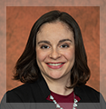
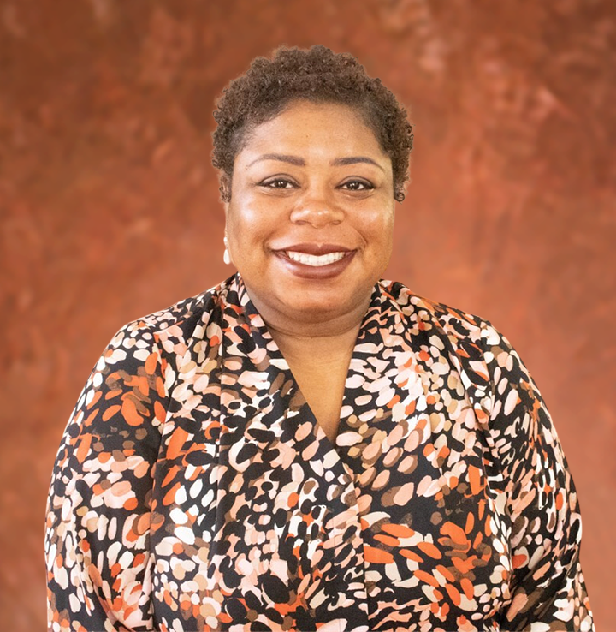
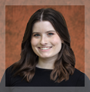
Maximize Your FSU Experience
Career Center: Your Career Liaisons
Get Help With
Career advising
Internship search and preparation
Occupational research
Résumé and cover-letter writing
Part-time and full-time jobs searches
Interview techniques
Graduate school application preparation
Pre-law advising
Alexis Fraites
Biological Science Neuroscience Psychology
a.fraites@fsu.edu
Jessica O’Neill
English, History, Humanities, Classics, Modern Languages, Philosophy, Religion
jo23n@fsu.edu
Jamie Butler
Science, Technology, and Mathematics disciplines
jmbutler@fsu.edu

Slide 16
Maximize Your FSU Experience
Check your FSU email daily.
See your academic adviser regularly and prior to registration opening for the next semester.
Keep copies of your academic/financial records.

Slide 17
Maximize Your FSU Experience
Know the academic calendar, registrar.fsu.edu/calendar/.
First day non-attendance – Be prepared for face-to-face classes
Drop/Add period – Fee liable for all courses on schedule as of 12 a.m. on the 5th day of classes
7th week deadline – Initial drop deadline and S/U deadline
12th week deadline – Late drop deadline
No grade forgiveness at FSU

Slide 18
Preparing for Advising
Before meeting with your adviser tomorrow, identify the Engage 100 and Freshman Interest Group opportunities you would like to pursue.
Be sure you have completed the enrollment survey through the Online Status Check, which documents any earned or anticipated college credit coming from high school dual-enrollment or accelerated exams.
Enrollment goals:
6-7 hours in Summer 2024 for students starting in summer
15 hours in Fall 2024

Slide 19
What Happens Now?
Resource Fair
Change Your Major (lower level)
Student Services (first floor)
Campus Activities (mezzanine)
Breakout Sessions – 3 p.m. and 3:30 p.m.
Career Center Essentials: Your Path to Success (Garnet 2)
Exploring Engage 100: First Year Success (Ballroom C)
Fraternity and Sorority Life (Club Downunder, lower level)
International Programs and Global Engagement (Senate Chambers)
Pre-Health at FSU (Garnet 3)
Pre-Law at FSU (Garnet 4)
Veterans Benefits (Gold 1)
Programming resumes at 4 p.m. in Ballrooms D and E

Slide 20
Welcome to Florida State!
Follow the college on social and the web for the latest news.
Instagram @fsuartssciences
LinkedIn @fsuartssciences
X @fsuartssciences
Facebook @FSUArtsAndSciences
artsandsciences.fsu.edu
Notes:
From biology to psychology, from English to religion, and so much more, the FSU College of Arts and Sciences is the place to prepare a career that will change the world. Our students are scientists and athletes, writers and linguists, award winners and noted scholars, and many achieve national recognition for their work even before graduation. We hope you find your place in the College of Arts and Sciences!
To learn more about the College of Arts and Sciences follow us on social and visit our website.
Welcome to Florida State!

